Slide 1

NIIT
Batch : MARCH-2026
“RECIPE -MANAGER”
CAPSTONE PROJECT-2
Victor Xavier Vijay M

Slide 2
OBJECTIVE:
The Recipe Master Database Project is a comprehensive relational database management system (RDBMS) designed to store, manage, and analyse culinary data.
With this SQL structure, the project enables advanced business and culinary insights, such as:
Nutritional Analysis: Finding high-protein/low-carb meals or calculating average calories per serving category.
Financial Insights: Identifying the most cost-effective recipes based on price-to-serving ratios.
Popularity Trends: Analysing which recipes receive the highest ratings relative to their review volume.
Inventory/Ingredient Mapping: Instantly generating shopping lists or finding recipes that use specific overlapping ingredients (e.g., "Find all recipes using Eggs and Flour").
Data Cleaning / Normalisation:
Successfully converted a "flat" dataset into a relational model. By separating ingredients into a different tables.
Converted strings into DECIMAL(10,2) for financial accuracy.
Formatted timestamps into proper DATETIME objects for chronological analysis.

Slide 3
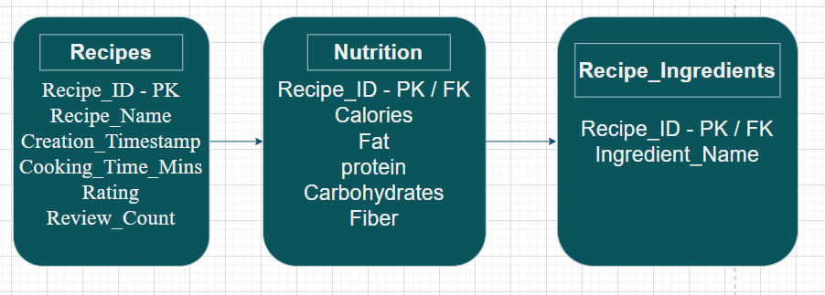
ERD Diagram:
To optimize the system, the project uses a Normalized Relational Model consisting of three primary tables:
Recipes Table: Stores core identity and metadata (Names, IDs, Ratings, Timestamps).
Nutrition Table: Stores health-specific data (Calories, Macros, Cholesterol).
Ingredients Table: A one-to-many table allowing for granular searching of individual ingredients.

Slide 4
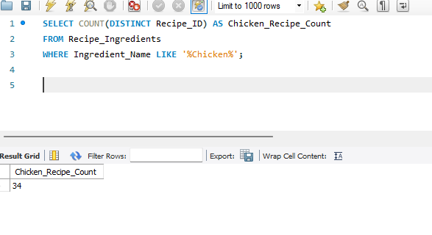
Ingredient Inventory Management
Requirement: The kitchen manager needs to know how many unique recipes use "Chicken" to plan bulk purchasing.
Insight: By placing wildcards on both sides, the query finds "Chicken" regardless of where it appears in the string. It will catch "Chicken Breast," "Diced Chicken," or "Organic Roast Chicken."
-

Slide 5
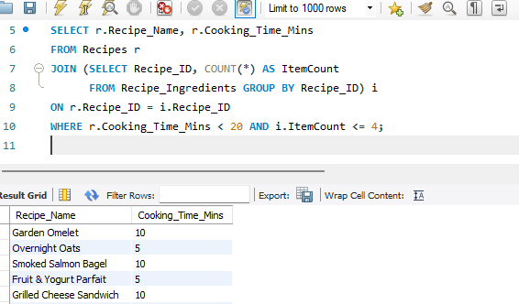
Low-Stock “Quick Fix Meals
Requirement: A user has very little time and needs a recipe that takes less than 20 minutes and requires 4 or fewer ingredients.
Insight: This demonstrates the ability to perform calculations on one table and filter based on another.

Slide 6
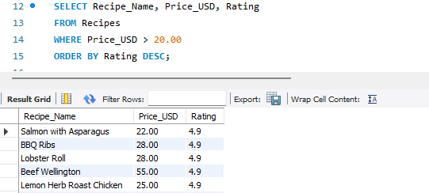
High-Value Menu Analysis
Requirement: Identify the "Premium" recipes—those priced above $20.00—and show their average rating to see if customers feel they are getting their money's worth.
Insight: Helps a restaurant owner decide if expensive items should stay on the menu based on quality.

Slide 7
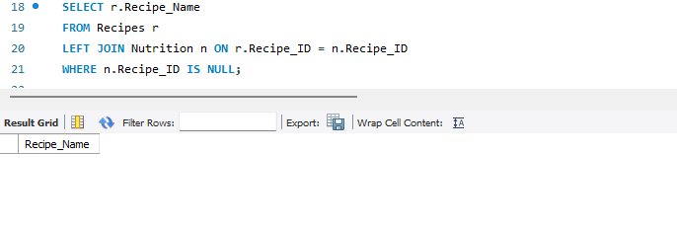
Identifying "Data Gaps"
Requirement: The system administrator needs to find any recipes that were created but haven't had their nutritional information entered yet.
Insight: This is a standard "Null Check" to ensure data completeness across a normalized database.

Slide 8
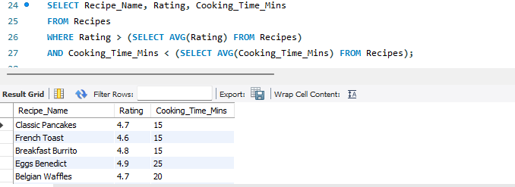
Most Popular "Efficiency" Recipes
Requirement: Find recipes that have a higher-than-average rating but take less time than the average cooking time of all recipes.
Insight: This identifies "high-ROI" recipes for busy users—maximum flavor for minimum time.

Slide 9
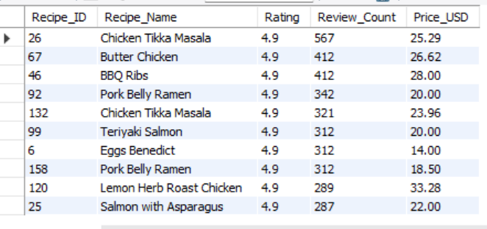
Automating Frequent Searches
Requirement: The front-end developers keep asking for the "Top 10 Best Rated" list. Instead of them writing complex SQL, create a virtual table they can just select from.
Insight: A View simplifies the interface for other developers and hides the underlying logic.

Slide 10
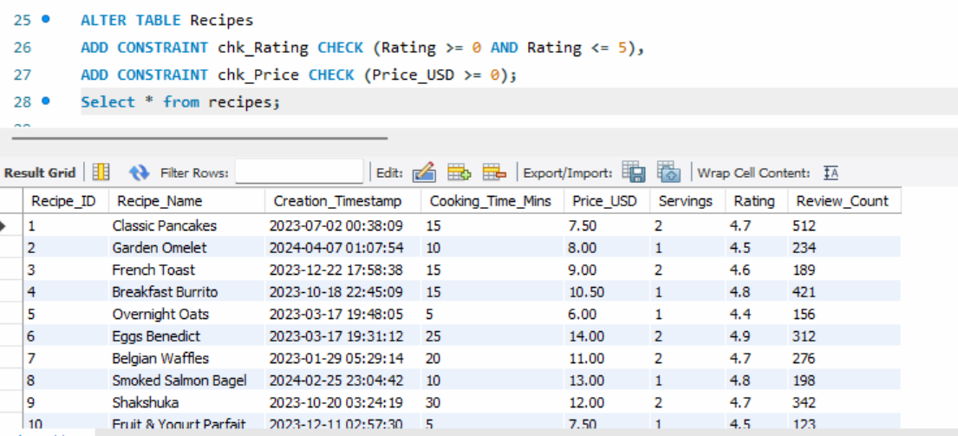
Preventing "Garbage Data" (Constraints)
Requirement: Management wants to ensure that no one accidentally enters a recipe with a negative price or a rating higher than 5.
Insight: Constraints ensure data integrity so the application doesn't crash due to invalid input.

Slide 11
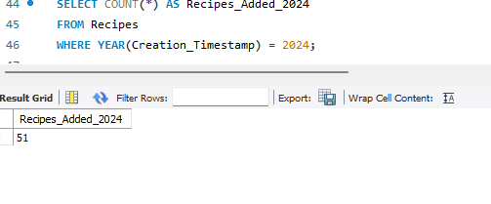
Analyzing Yearly Content Growth
Requirement: The platform started in 2023. How many recipes were added in 2024 specifically?
Insight: Essential for reporting on business growth and user activity over time.

Slide 12
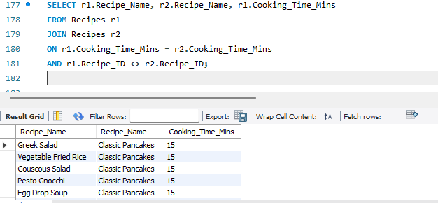
Recipes With Same Cooking Time
Requirement: Find recipes having identical cooking times.
Insight: Finds duplicate values across rows.

Slide 13
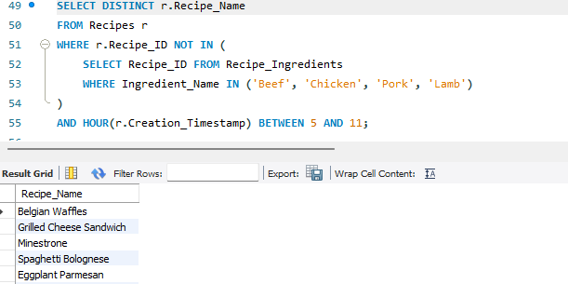
Multi-Criteria Search (Complexity)
Requirement: A user wants a "Vegetarian-friendly" breakfast. Find recipes that do not contain "Beef", "Chicken", or "Pork" and are tagged with a breakfast-related timestamp (morning).
Insight: Retrieves unique vegetarian recipes that were created during morning hours.

Slide 14
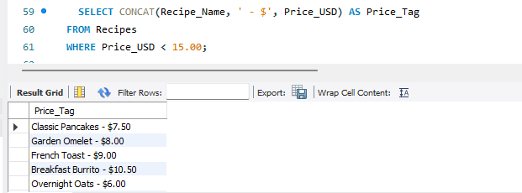
Dynamic Menu Labels
Requirement: The UI needs a "Price Tag" display that combines the recipe name and its price with a currency symbol, but only for items cheaper than $15.00.
Insight: This formats data directly in the database to reduce the processing load on the application's front-end.

Slide 15
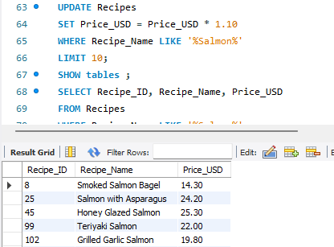
Seasonal Price Update
Requirement: Due to a seasonal increase in ingredient costs, the manager wants to increase the price of all "Salmon" dishes by 10%.
Insight: Shows how to perform bulk updates safely without affecting the entire table.

Slide 16
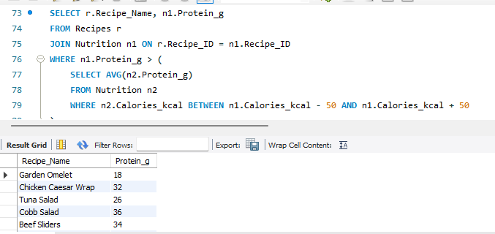
High-Protein Benchmark
Requirement: Find recipes that provide more protein than the average protein content of other recipes in the same calorie range.
Insight: This is a sophisticated analytical query that compares a row against a specific "peer group" rather than the whole table.

Slide 17
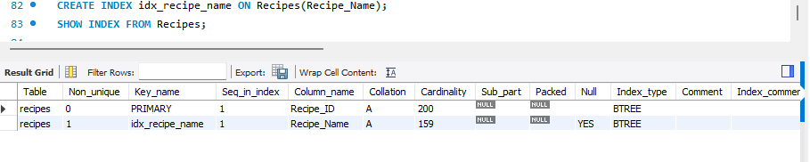
Speeding Up Search
Requirement: The app is lagging when users search for recipes by name. How do you optimize this?
Insight: Indexes allow the database to find rows without scanning every single record, which is vital as the Recipes table grows.

Slide 18
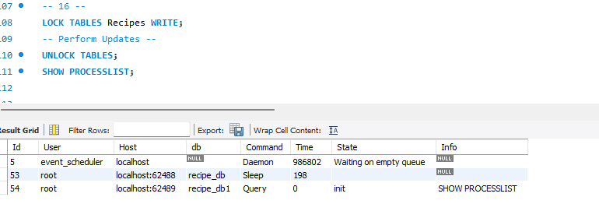
Concurrent Access Management
Requirement: Two employees are editing the same recipe price simultaneously. How do you prevent data conflict?
Insight: Locking prevents "Other Level Employees" from modifying the data while a critical update is in progress, ensuring consistency.

Slide 19
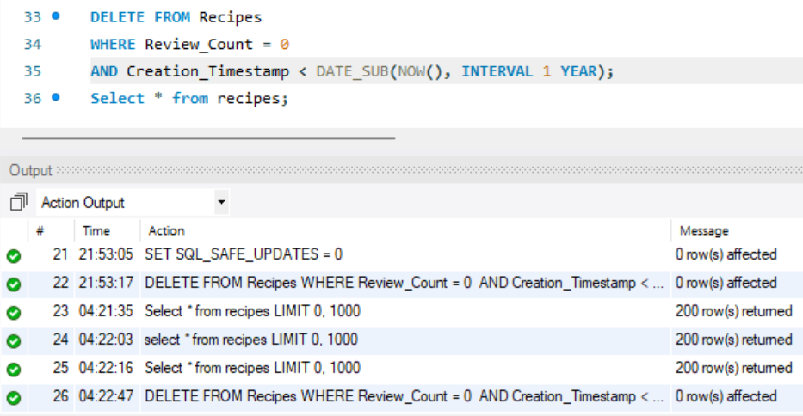
Cleaning Inactive Data
Requirement: The manager wants to delete all recipes that have 0 reviews and were created over a year ago.
Insight: Periodically removing "dead weight" data keeps the database lean and performant.

Slide 20
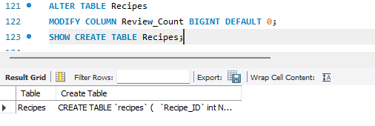
Structural Evolution
Requirement: You realized that the Review_Count might eventually exceed the limit of a standard INT. How do you change it?
Insight: Shows how to evolve the database schema without losing existing data.

Slide 21
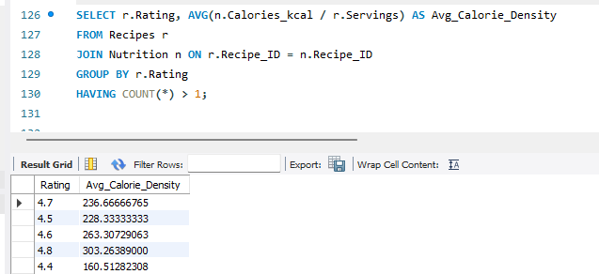
Nutrition Density Summary
Requirement: For each recipe, calculate the "Calorie Density"—total calories divided by servings—and group them by their rating.
Insight: This helps to find the high-calorie meals & low-calorie meals.

Slide 22
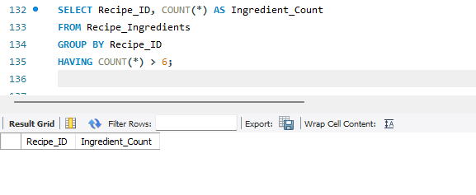
Finding Most Ingredient-Heavy Recipes
Requirement: Identify recipes that use more than 6 ingredients.
Insight: HAVING filters grouped results after aggregation.

Slide 23
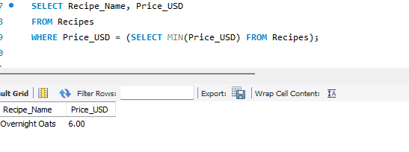
Cheapest Recipe Available
Requirement: Find the lowest-priced recipe.
Insight: Subquery finds minimum value; outer query retrieves details.

Slide 24
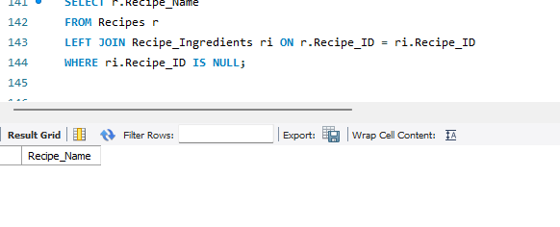
Recipes Without Ingredients
Requirement: Find recipes that have no ingredients listed.
Insight: Detects missing related records

Slide 25
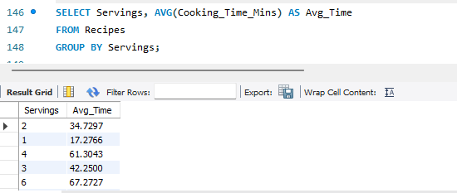
Average Cooking Time by Servings
Requirement: Analyze average cooking time based on servings.
Insight: Groups recipes and calculates average per category.

Slide 26
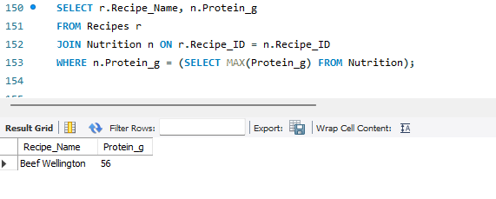
Highest Protein Recipe
Requirement: Find recipe with maximum protein.
Insight: Identifies top nutritional value.

Slide 27
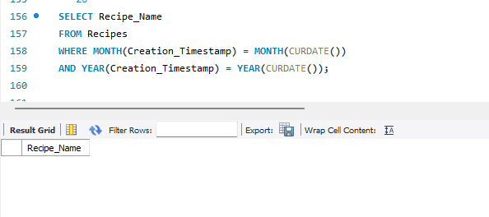
Recipes Created This Month
Requirement: Retrieve recipes created in the current month.
Insight: Filters by current system date.

Slide 28
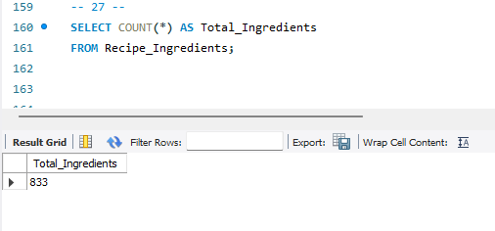
Counting Total Ingredients Used
Requirement: Count total ingredient entries in database.
Insight: Counts all rows.

Slide 29
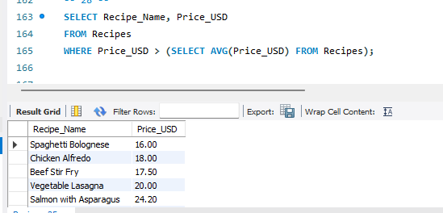
Recipes Above Average Price
Requirement: Find recipes costing more than average.
Insight: Compares row with global average.

Slide 30
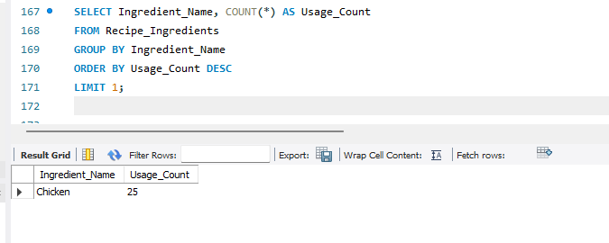
Ingredient Frequency Analysis
Requirement: Find most commonly used ingredient.
Insight: Frequency analysis.

Slide 31
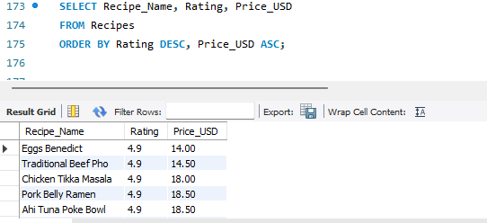
Sorting Recipes by Rating and Price
Requirement: Show best-rated cheapest recipes first.
Insight: It sorts those specific 5-star recipes from the cheapest to the most expensive.

Slide 32
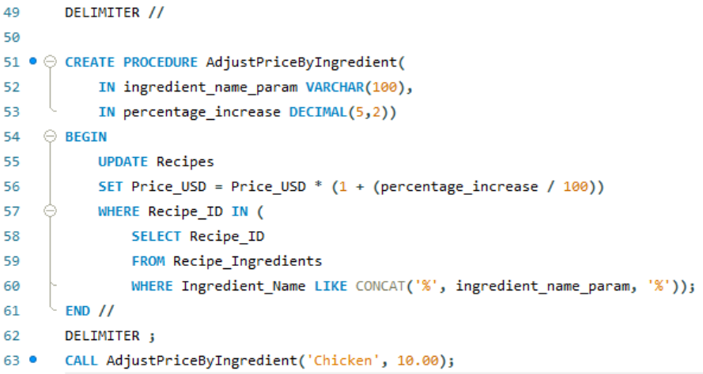
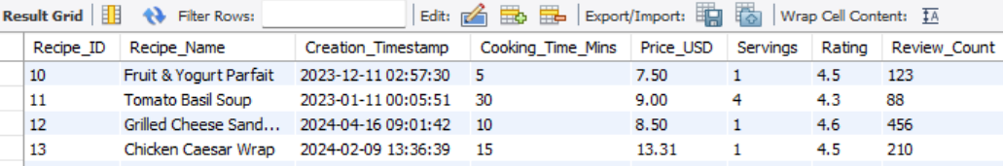
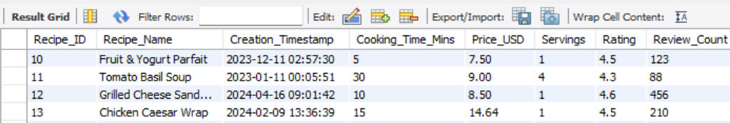
The "Inflation Adjustment" Tool
Requirement: The kitchen manager noticed that meat prices have risen by 10%. Instead of manually updating every single recipe price, they want a way to increase prices for a specific category of food by a percentage.
Insight: Create a stored procedure that takes an Ingredient Keyword (e.g., 'Chicken') and a Percentage (e.g., 10.00) and increases the Price_USD of every recipe containing that ingredient.

Slide 33
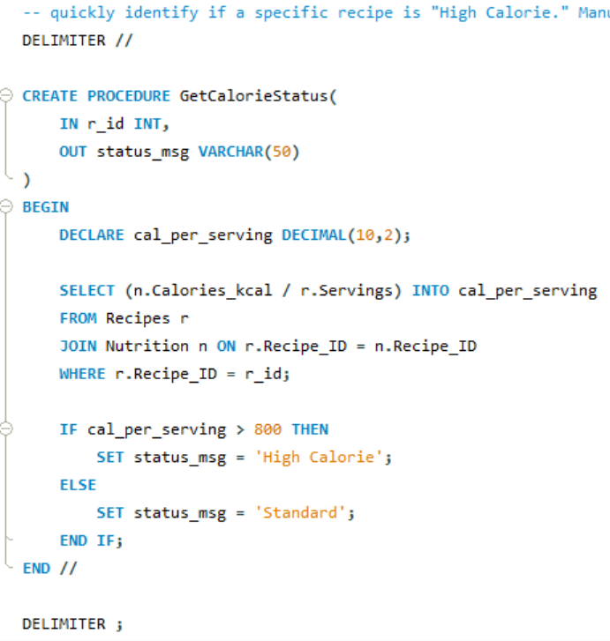
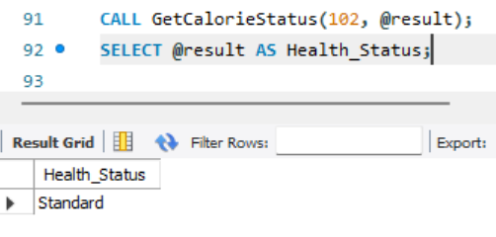
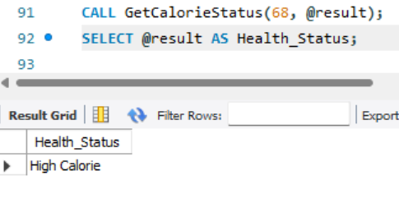
The "Health Audit" Report
Requirement: The nutritionist needs to quickly identify if a specific recipe is "High Calorie." Manually checking the Nutrition and Recipes tables for every dish is too slow.
Insight: Stored procedure that takes a Recipe ID and returns a status message. If the calories per serving are greater than 800, it should return "High Calorie"; otherwise, it should return "Standard."

Slide 34
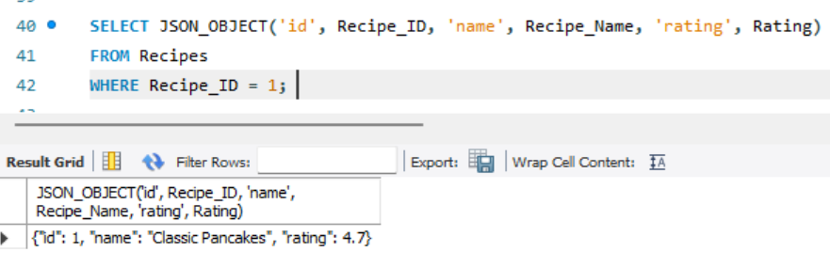
Exporting to Web Apps
Requirement: A partner website needs our recipe data in JSON format for their API.
Insight: Demonstrates modern SQL capabilities where relational data is bridged with web-standard formats like JSON.

Slide 35
Project Summary
The Project Recipe Manager is a database-driven application designed to streamline kitchen operations, nutritional analysis, and menu management. The project focuses on transforming raw culinary data into actionable insights through a normalized relational database.
Key functionalities demonstrated in the project include:
Operational Efficiency: Tools for ingredient inventory management, such as counting unique recipes for specific ingredients to assist in bulk purchasing.
User-Centric Features: "Quick-fix" meal identification for users with limited time and specific ingredient constraints.
Business Intelligence: High-value menu analysis that correlates pricing tiers with customer satisfaction (ratings) to help owners optimize their menus.
Data Integrity and Maintenance: Implementation of automated "Data Gap" audits to find missing nutritional information and the use of constraints to prevent invalid data entry (e.g., negative prices or ratings over 5).

Slide 36
Performance Optimization: Use of B-Tree indexes to speed up recipe searches and "Views" to simplify complex queries for front-end developers.
Advanced Automation: Stored procedures for dynamic tasks, such as bulk inflation adjustments based on specific ingredients and automated health audits to categorize recipes by calorie density.
Conclusion:
Project Recipe Manager successfully demonstrates the power of a well-structured SQL database in a modern culinary environment. By bridging the gap between relational data and practical applications—such as JSON exports for web APIs and sophisticated analytical subqueries—the project ensures that a kitchen can remain both data-informed and operationally lean. Ultimately, the system provides a robust framework for managing data growth while maintaining high standards of data accuracy and retrieval speed.

Slide 37
THANK YOU

